Slide 1
CPR Equality Design Product
Tumani Jackson, BSN, RN
University of Minnesota, Doctor of Nursing Practice Student Health Innovation and Leadership Specialty

Slide 2
Case Introduction
Health care and the lack of access to educational opportunities is another issue that Black/African American’s face (Hostetter & Stein, 2018). “Compared with whites, members of racial and ethnic minorities are less likely to receive preventive health services and often receive lower-quality care. They also have worse health outcomes for certain conditions” (Hostetter & Stein, 2018).
The New England Journal of Medicine conducted a study and pulled out-of-hospital cardiac arrest data from 2013 – 2019 (Garcia et. al, 2022). The study found, “Black and Hispanic persons were less likely to receive bystander CPR at home (38.5%) than White persons (47.4%) (adjusted odds ratio, 0.74; 95% confidence interval [CI], 0.72 to 0.76) and less likely to receive bystander CPR in public locations than White persons (45.6% vs. 60.0%) (adjusted odds ratio, 0.63; 95% CI, 0.60 to 0.66).

Slide 3
Case Introduction Continued…
This project will take place at local community center where low income come individuals come to receive healthcare services. This project will focus on creating a template for helping Black and Hispanic individuals learn CPR. The goal is to create a safe and positive environment that will give Black and Hispanic individuals the opportunity and confidence to learn and perform an important life saving skill.

Slide 4
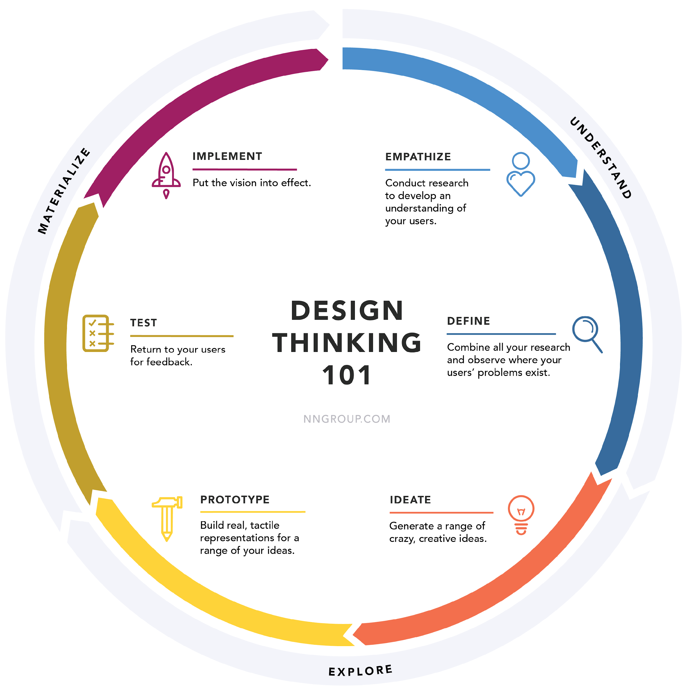
A Design Thinking Approach

Slide 5
Research Activity: Literature Review
The inequalities facing African Americans go deeper than just interactions with police: from lower wages to longer commute times, the structure of the world's largest economy deeply marginalizes black people” (Stein, 2020).
According to the New England Journal of Medicine (2022) out of 110, 054 cardiac arrests, 35,469 of those were Black or Hispanic individuals (Garcia et. al 2022).
According to Garcia et al. (2022) “CPR training is less commonly conducted in Black and Hispanic communities, and dispatcher – assisted bystander CPR may not be as readily available.

Slide 6
Research Activity: Observations
A 2022 census stated that the local city where the community center is located consists of 35.9% Black/African-American individuals and 13.8% Hispanic identifying individuals.
Only 13.5% of people within this community have health insurance. (Lincoln Community Center, 20
When speaking with team members from this community center concerns that were addressed:
Lack of Health Literacy education.
Strong trust of members within the community and the community center
Greater compliance in their 65+ generation in maintain appointments and eagerness to be compliant with medical advice.

Slide 7
Research Questions:
I plan to have a survey to understand what participants know and understand about CPR.
I plan to do a pre and post survey on their confidence to perform CPR in the event of an emergency.
Notes:
Same as co creation.
Survey for research - make survey

Slide 8
Constraints
Due to class and time constraints, I have not been able to implement this prototype into the community.
I have only been able to meet with one community leader about the process and how we would implement this program into their community center.

Slide 9
Design Thinking Process
Empathize
The users are Black and Hispanic individuals within the local community center. These are low-income individuals.
Define
After speaking with community center leaders and understanding the data of low-income individuals in relation to CPR, there is no question that there is a lack of CPR education/training amongst these individuals.
Ideate
Using role-play and music will help teach these individuals learn CPR. This allows for a fun and interactive environment. Studies show that individuals retain information better when music is involved.

Slide 10
Design Thinking Process Continued…
Prototype
Creating a business card that has the CPR steps on it to help individuals in a real time and life situation.
Test
After a class has been completed, we will evaluate each community member to see if the methods and the information were of value to them.
Implement
These methods will be used in community center to help further educate Black and Hispanic individuals on CPR. Trained member will be able to use the skills in real life settings.

Slide 11
Empathy Map
Doing
Thinking
Feeling
Recognize CPR is needed.
Uses CPR card to perform.
CPR steps and call 911.
Saving a life.
Power and ability to do good.
A community hero when a life is saved or an attempt was made.
Happy.
Accomplished
Smart
Hero

Slide 12
Prototype Proposal
Participatory Design Research
- The proposed approach to design includes all stakeholders to help meet the needs of the community.
Interviews
Studies
Role-playing
Interactive Music therapy
CPR step by step business card.
CPR app w/ 911 abilities
This helps keep the people involved and engaged in information that may be new and cause hesitancy and fear.

Slide 13
Concepts 1 & 2:
Music
Learning CPR depth and rhythm can be difficult to those who may have never been in a real-life CPR situation. Being able to perform CPR requires a certain cadence and depth with each compression.
Role Playing
CPR is an interactive and true-life skill event. Practicing on mannequins or paring up in groups to create a scenario will be helpful in teaching.

Slide 14
Research Evidence
Music and Memory
“Music can help to improve memory and retention. When we listen to music, our brain releases dopamine, a chemical that helps to increase our “good” feelings. These positive feelings can help us memorize or recall information more easily. The primary way music helps us retain information is by engaging in the parts of the brain responsible for memory and learning” (Shulman, 2023)
Music and Concentration
“Music can improve concentration and focus. Listening to music helps you concentrate and focus on tasks that require mental effort. This technique can be beneficial while studying or working on a challenging project. Music can also block distractions and create a conducive learning environment, which helps with staying on task” (Shulman, 2023)

Slide 15
Research Evidence
Why Role Playing?
“Role playing is an effective learning method for adult education because it increases learning retention, provides hands-on training, and enables better teamwork and communication. Adults learn more when they have fun while learning” (California HealthCare Foundation, 2006).

Slide 16
Prototype Plan/Produce
What are you making?
CPR knowledge template for low income individuals
What is the journey/scenario?
We will interview individuals to understand how they learn.
We will use role playing and songs to help them understand the scenario and how to respond to a cardiac arrest.
What will you test?
Knowledge and willingness to perform CPR in the event it occurs in a real life situation.
The user’s ability to remember the correct CPR methods and steps.
What do you predict:
Increase knowledge
Confidence
Feeling of power
Increased minority CPR rates.

Slide 17
Prototype 1: CPR Steps Business Card
KEEPIN’ THE BEAT LLC.,
HELP ME SAVE A LIFE CPR CARD
1. Asses the scene for safety
2. Check to see if the person responds.
3. Carotid artery on the neck to see if the individual has a pulse
4. Call 9-1-1
5. Begin CPR (30 chest compressions to the beat of Tempo – Lizzo)
6. Give 2 breaths after 30 compressions w/ head tilted back.
7. Resume CPR steps from #5 & #6 while waiting on help from emergency services.
You can do this and you’re doing great! You are a hero!

Slide 18
Prototype Revise
After testing this product, the next step would be to ensure that users feel comfortable with it and find it useful.
Making the prototype paperless
Help make it more convenient for user
Quicker access to CPR
Reduce carbon footprint
Less chance for misplacement

Slide 19
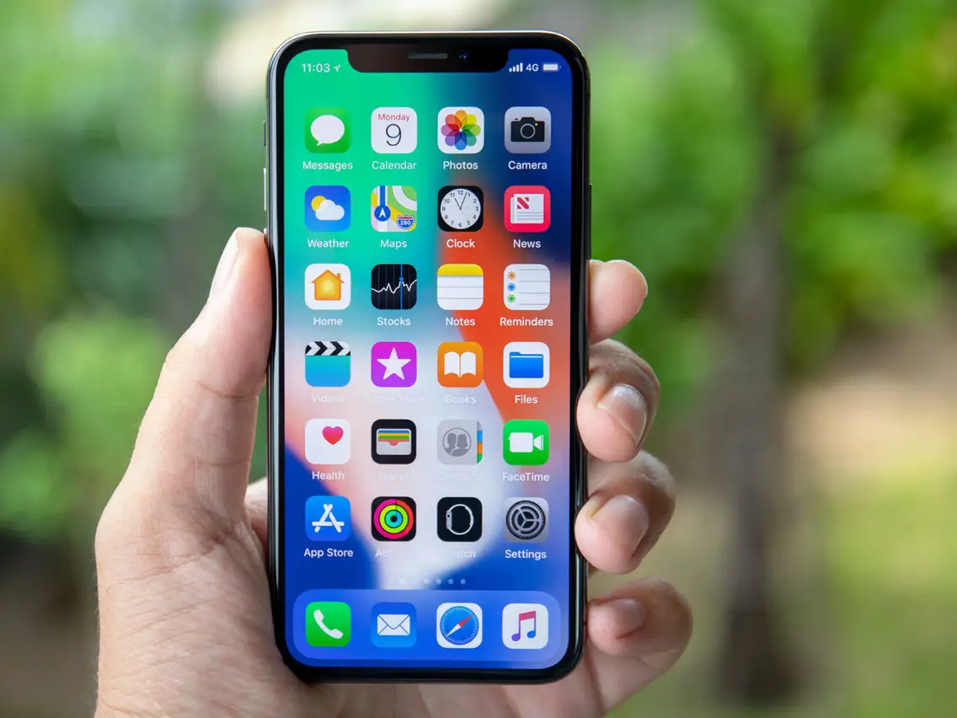
Prototype 1: Product Revise
1. The new product (app) will be able to call 911 after user safely assesses the scene.
2. The app will also verbally tell steps.
3. Play appropriate rhythm song to perform CPR.

Slide 20
Conclusion
CPR is a life saving measure that is beneficial to not only receive but learn.
CPR can be imitating, but with proper training and education can be easy to learn.
CPR in minorities, especially minorities that have less educational opportunities is a problem within our society.
This product teaches, engages, and helps individuals of minority background feel confident in a life saving measure.

Slide 21
References:
Garcia, R. A., Spertus, J. A., Girotra, S., Nallamothu, B. K., Kennedy, K. F., McNally, B. F., Breathett, K., Del Rios, M., Sasson, C., & Chan, P. S. (2022). Racial and ethnic differences in bystander CPR for witnessed cardiac arrest. New England Journal of Medicine, 387(17), 1569–1578. https://doi.org/10.1056/nejmoa2200798
Shulman, R. D. (2023, January 10). 5 ways music affects learning. MarketScale. Retrieved April 26, 2023, from https://marketscale.com/industries/education-technology/5-ways-music-affects-learning/
Stein, C. (2020, June 5). Black Americans suffer from generations of economic marginalization.
U.S. Census Bureau quickfacts: Durham County, North Carolina. (n.d.). Retrieved April 30, 2023, from https://www.census.gov/quickfacts/durhamcountynorthcarolina
Umber 12 I May 2006 fast facts - california health care foundation. (n.d.). Retrieved April 30, 2023, from https://www.chcf.org/wp-content/uploads/2017/12/PDF-FFRolePlaying.pdf

